Slide 1
OrganizApp
By Guillermo Sanchez

Slide 2
What is OrganizApp?
OrganizApp is an app that:
• Enables people to connect to their organizations
• Keeps communities together
• Removes the need to worry about data privacy

Slide 3
How does it OrganizApp Work?
First Step
- Add your organization
You’re Done!
Notes:
Show demonstration

Slide 4
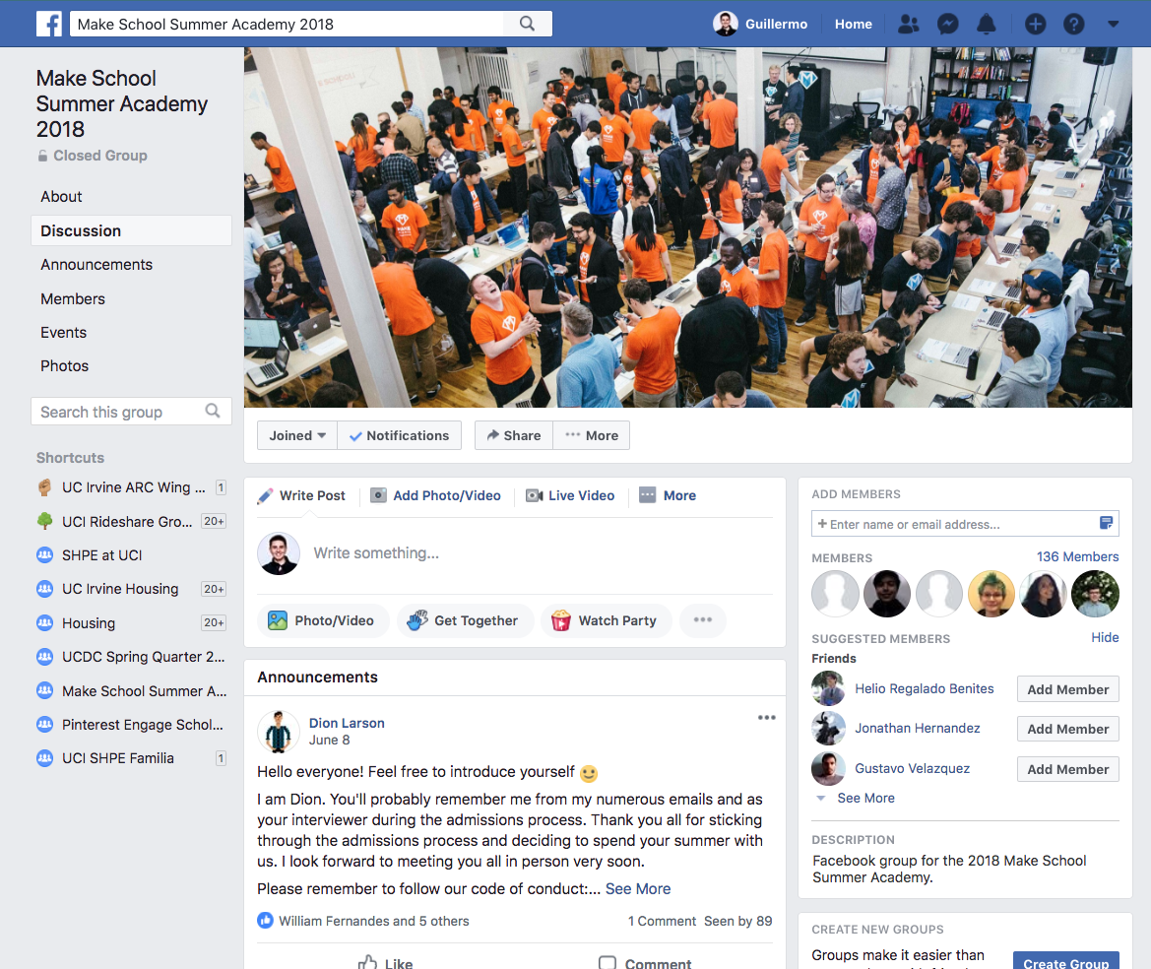
Why OrganizApp?
Why should I use OrganizApp if I can easily stay in touch with my groups on Facebook or other social media?

Slide 5
Why OrganizApp?
NEW MESSAGE
Update your birthday, address, interests, and your location! Your friends SHOULD know where you are (as well as hackers)
Other Social Media:
Add Friends!
Trending near you
Sign up?
Get approved to join group
Add your contacts?
Confirm Account
Add organization/group
People you may know!
Add Friends!
READ ME

Slide 6
Why OrganizApp
OrganizApp:
Add organization
Start
Added

Slide 7
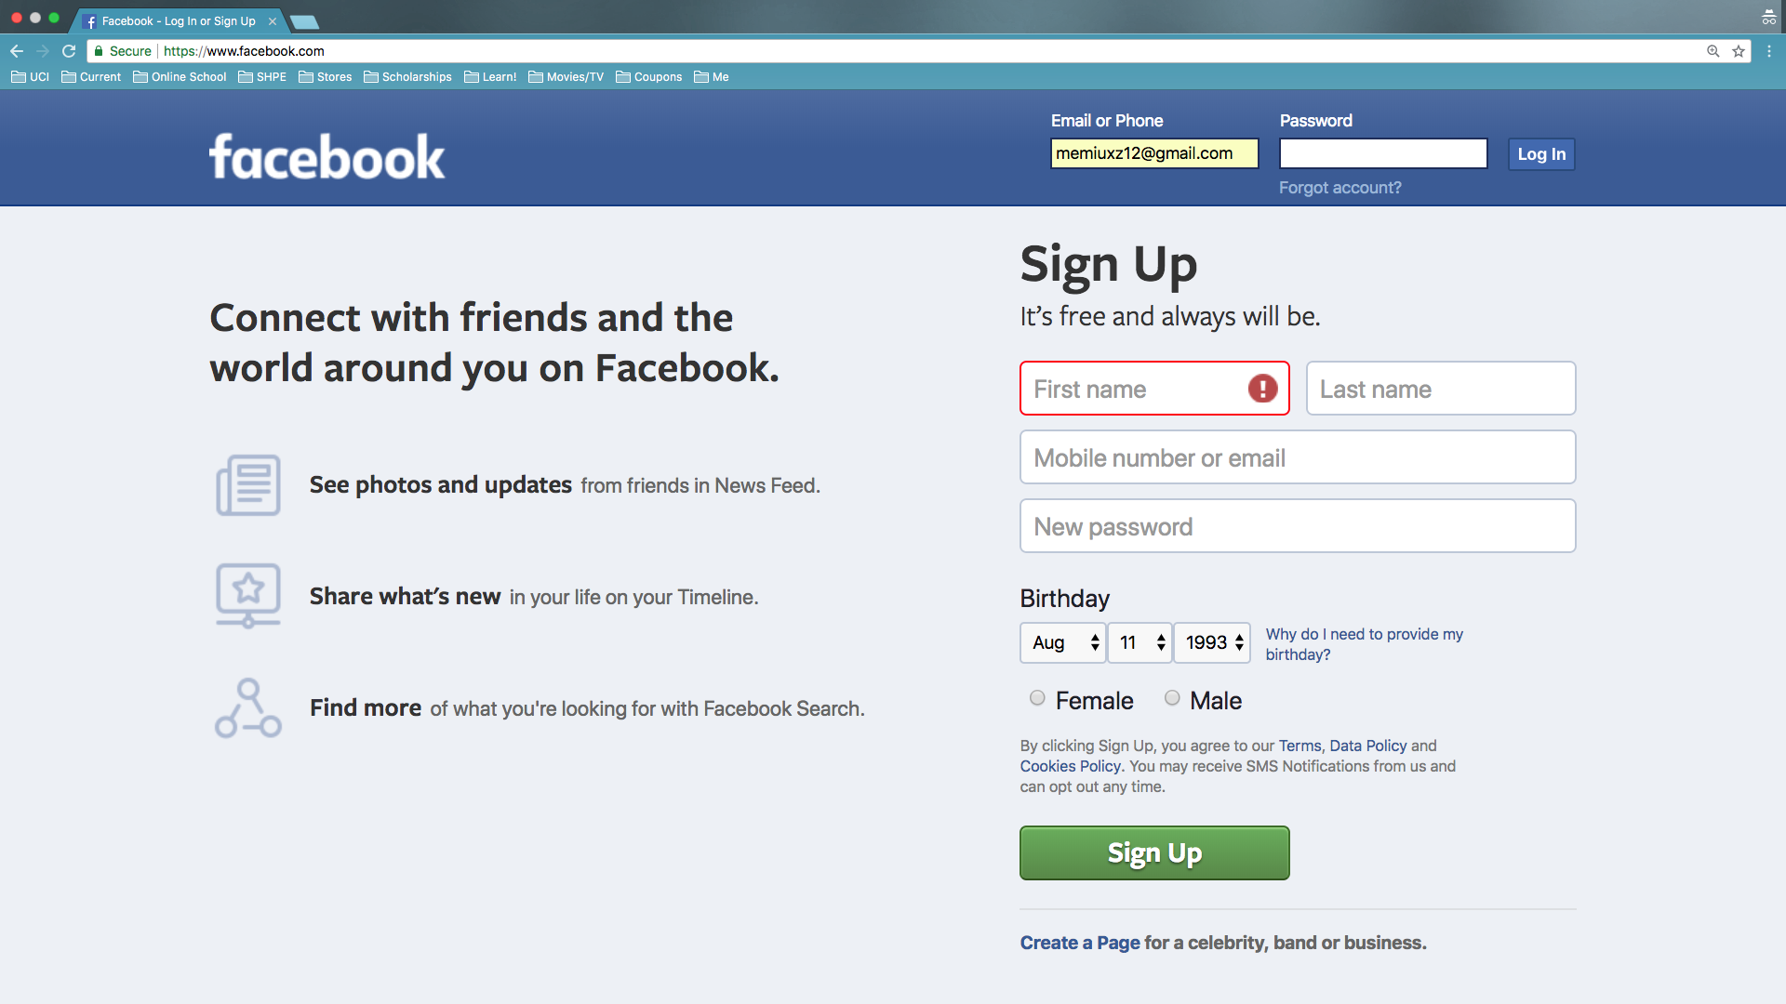
UI/UX Analysis of Facebook

Slide 8
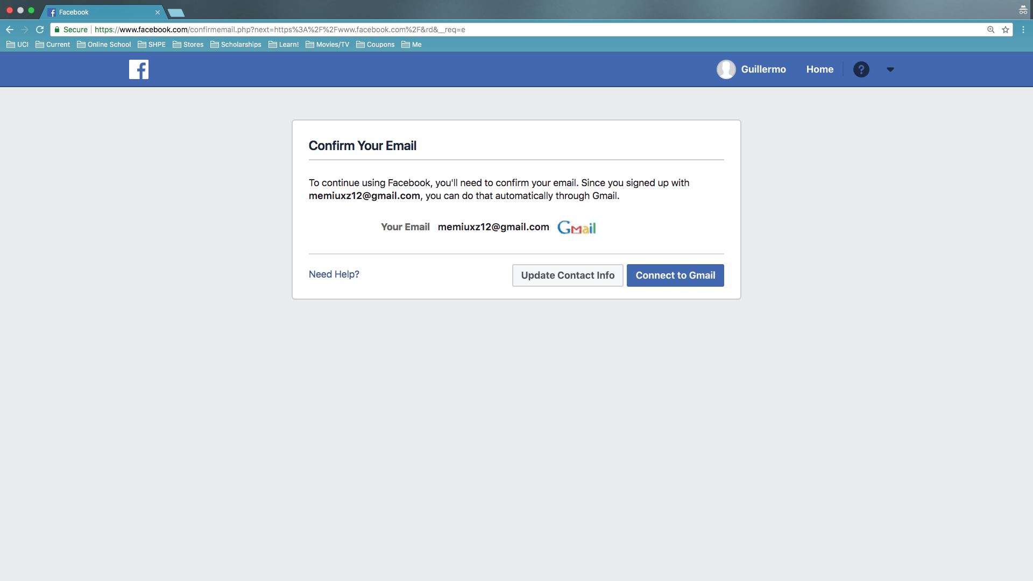
UI/UX Analysis of Facebook

Slide 9
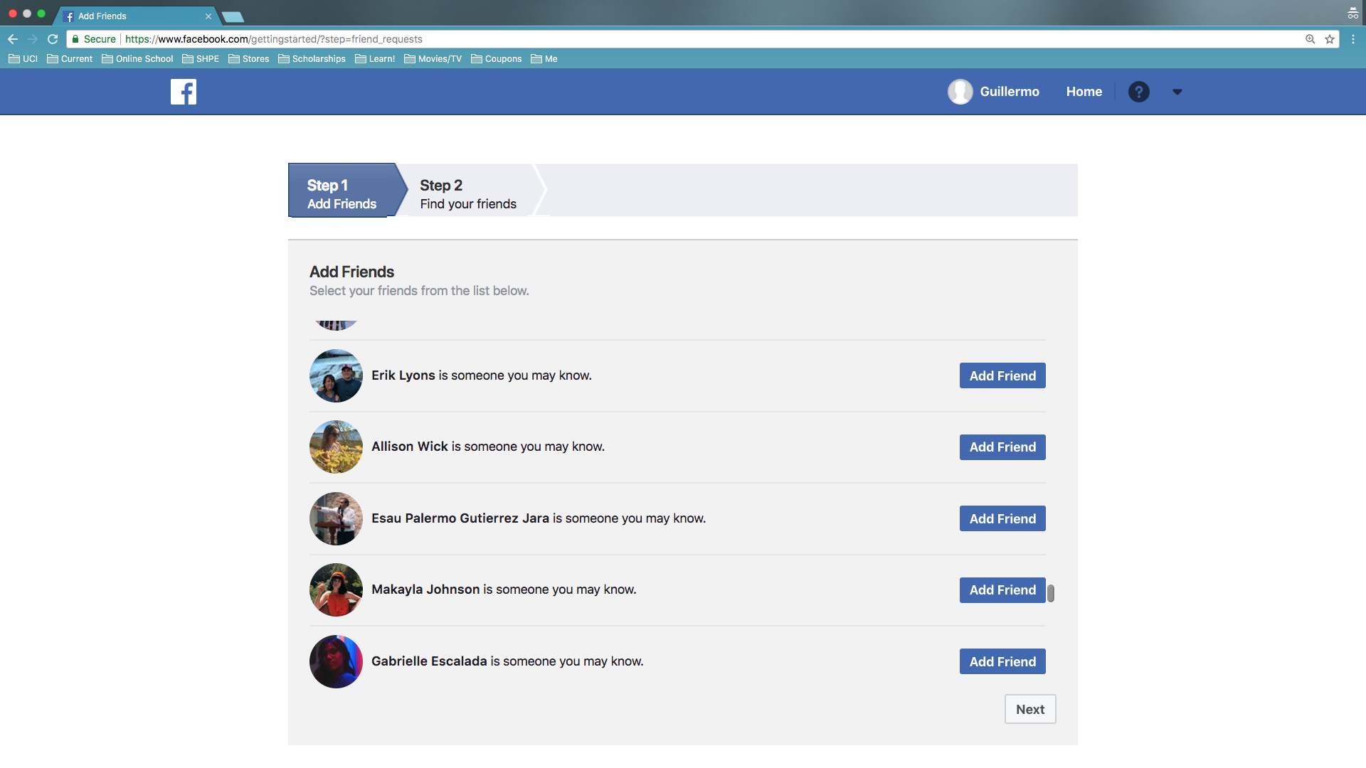
UI/UX Analysis of Facebook

Slide 10
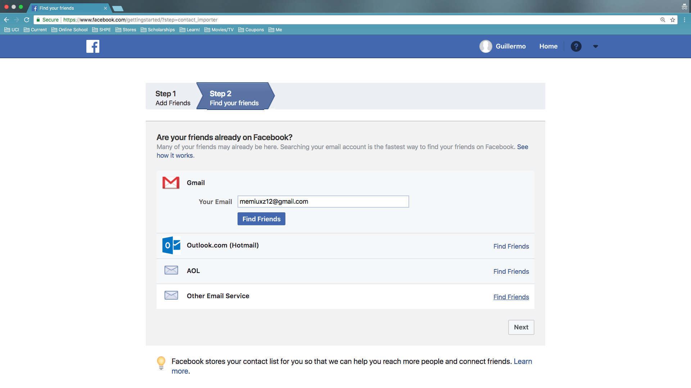
UI/UX Analysis of Facebook

Slide 11
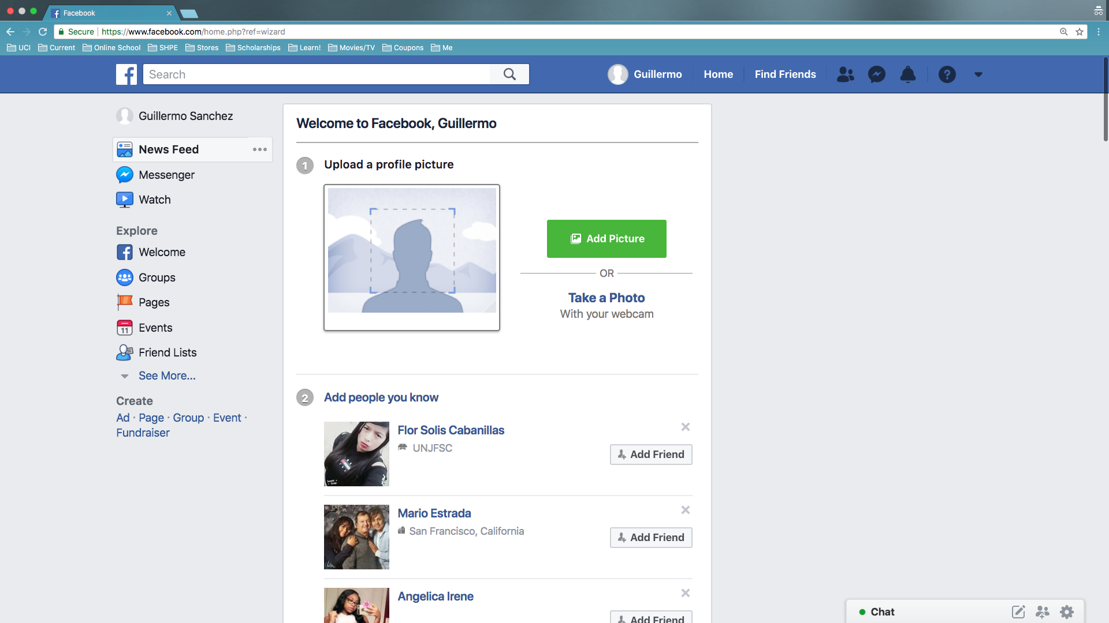
UI/UX Analysis of Facebook

Slide 12
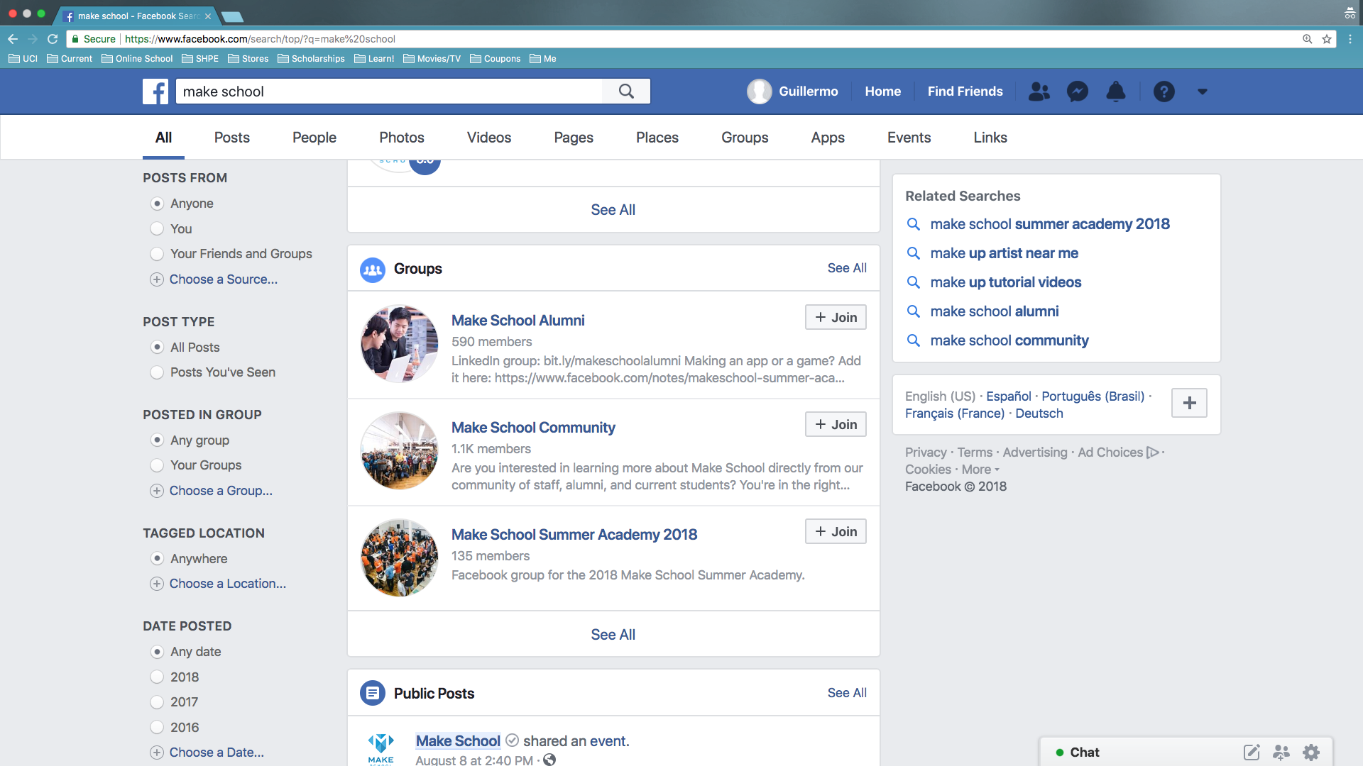
UI/UX Analysis of Facebook

Slide 13
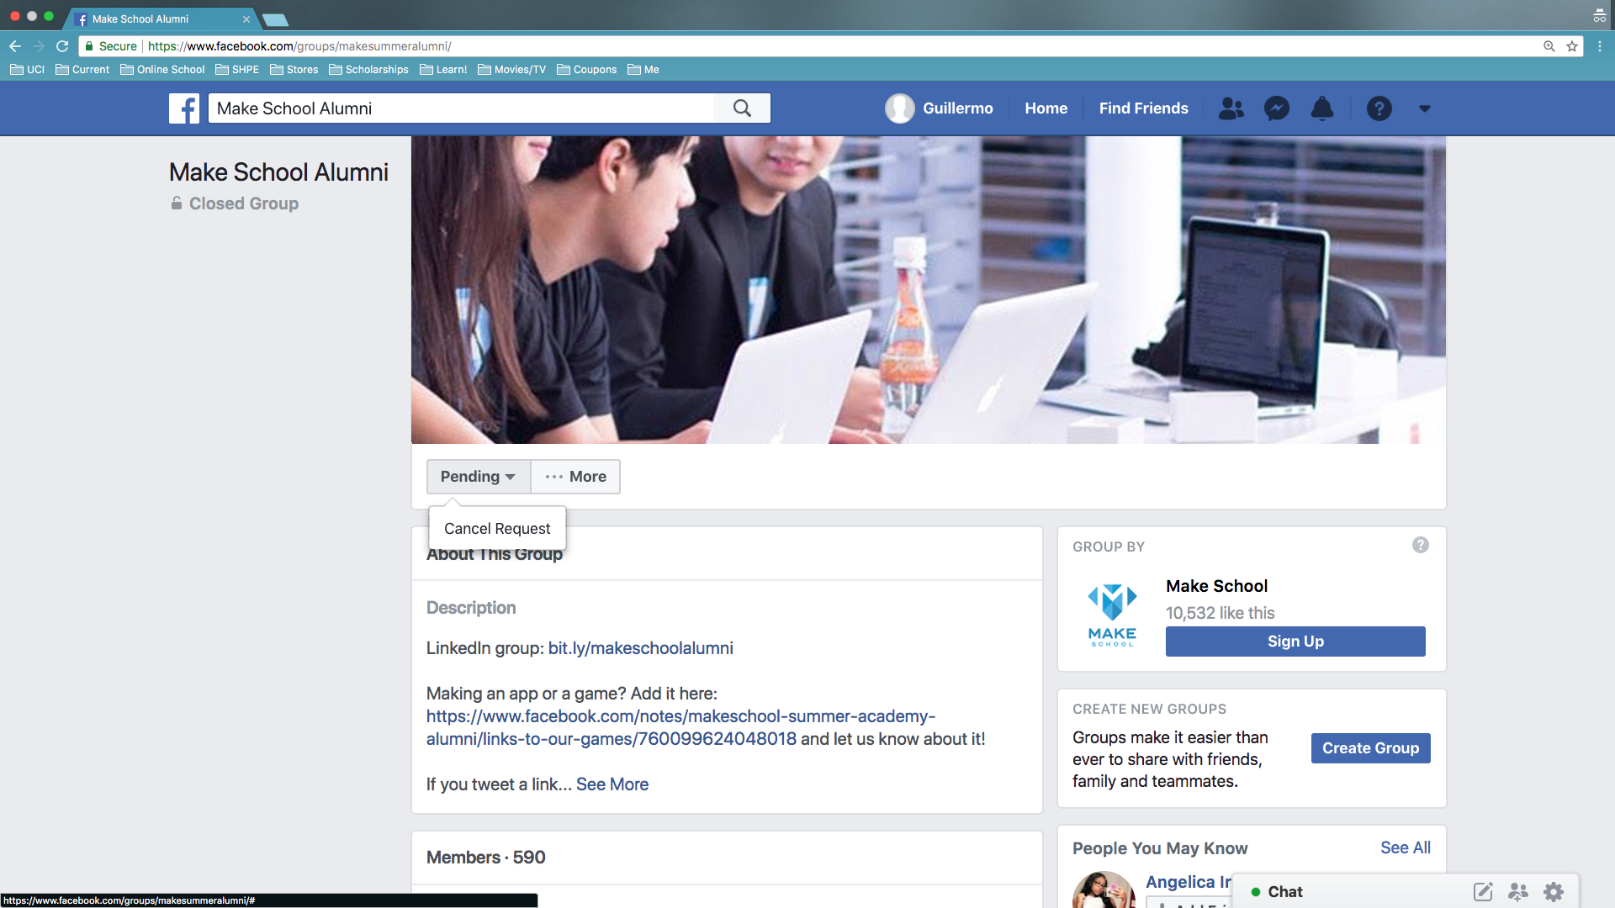
UI/UX Analysis of Facebook

Slide 14
Why OrganizApp?
OrganizApp:
Add organization
Start
Goal

Slide 15
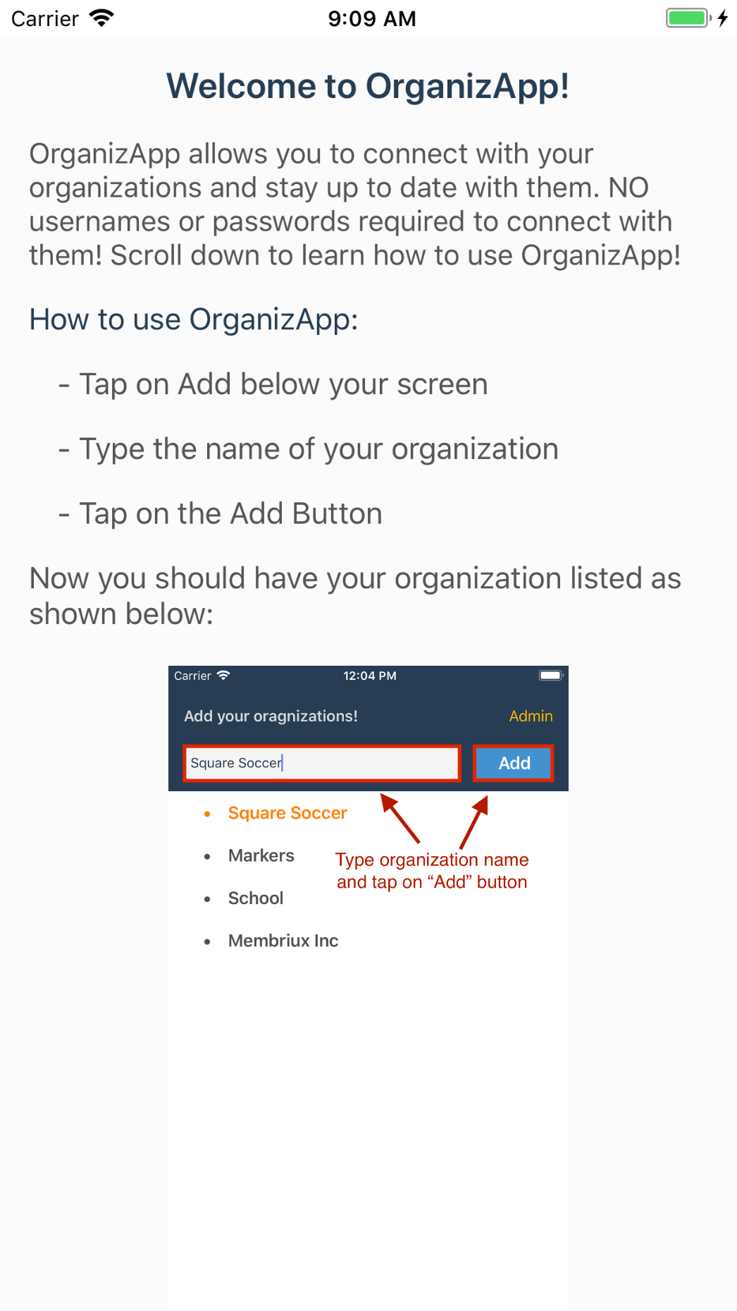
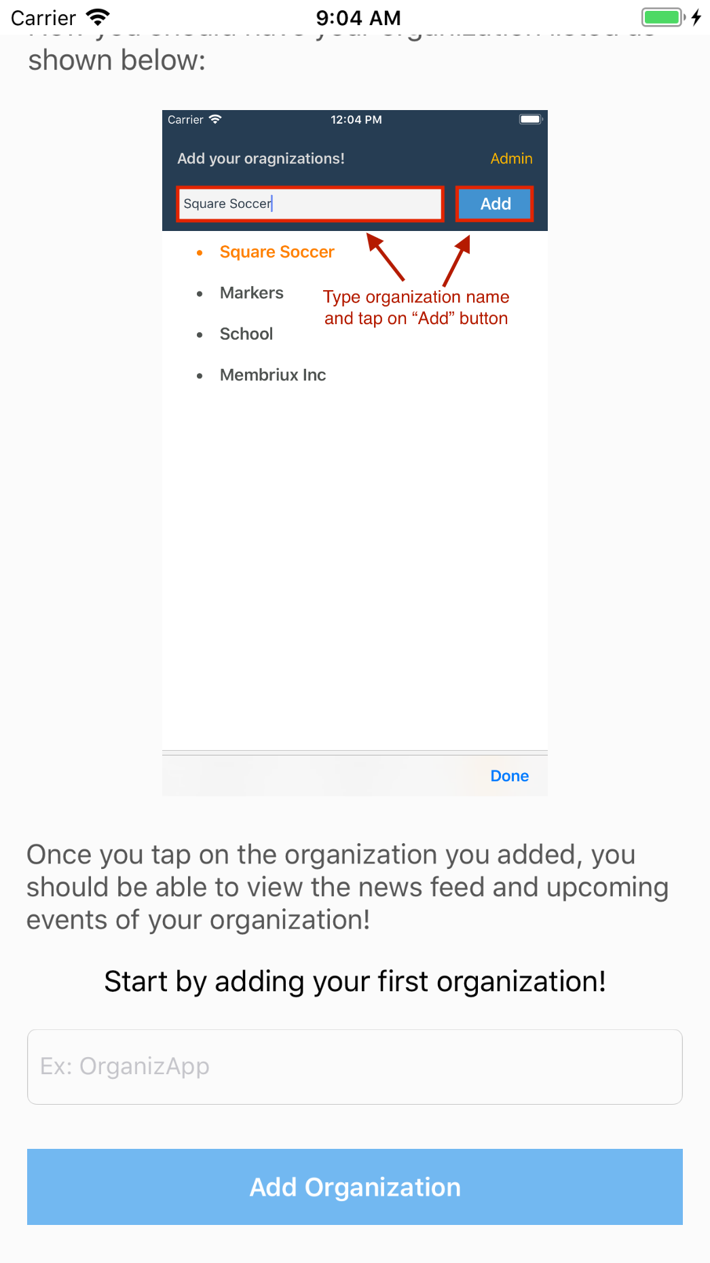
UI/UX Analysis of OrganizApp
Scroll down

Slide 16
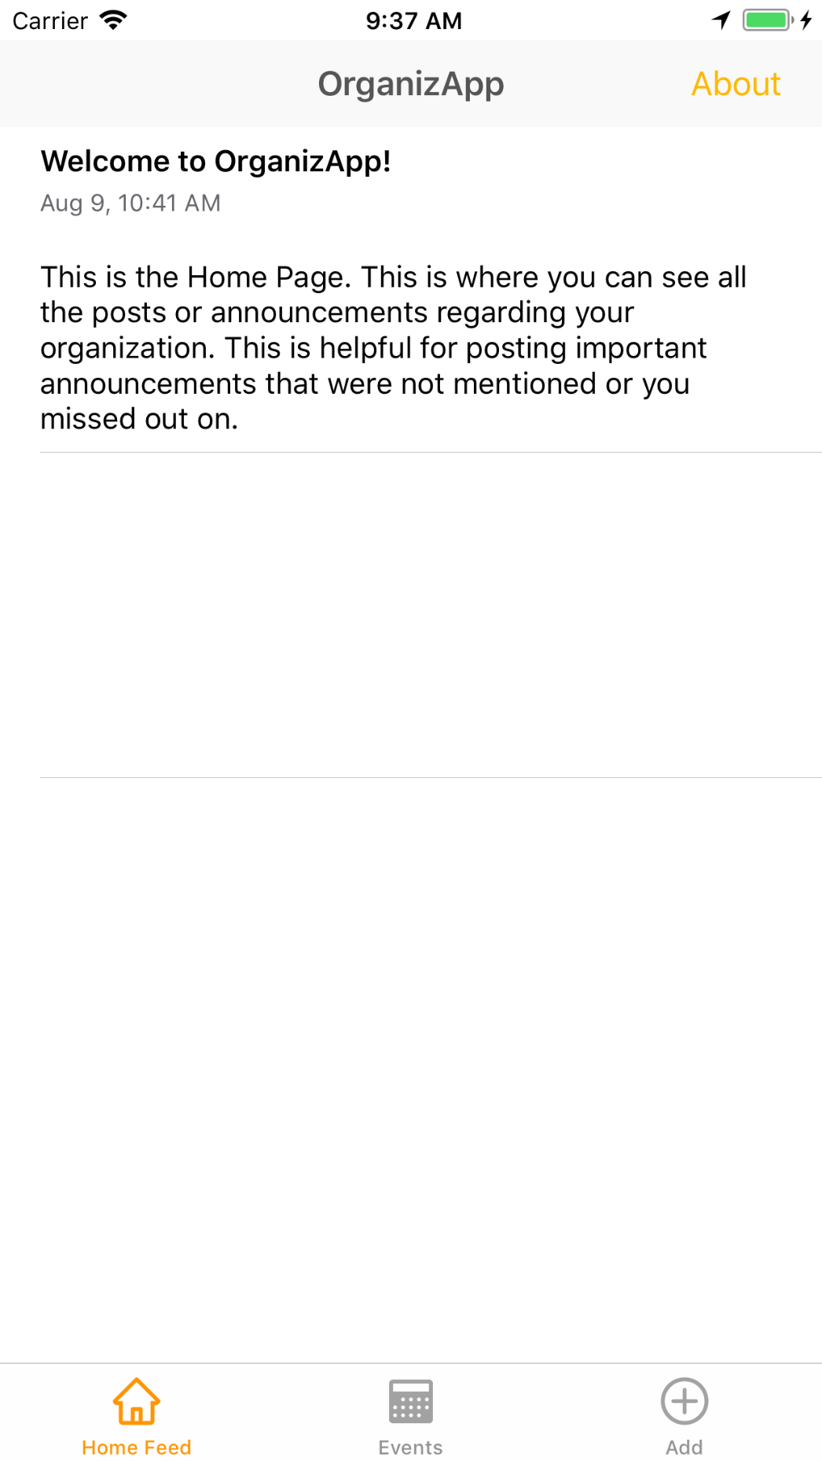
UI/UX Analysis of OrganizApp
Easy money ;)

Slide 17
That’s OrganizApp

